Slide 1


The impacts of Covid-19 cases upon real estate sales in Victoria
Jeremy Chia – Anna Nguyen - Matthew Taylor - Kenny Dao

Slide 2







Presentation summary
The big question
Working questions
Data Collection
The analysis process (Jupyter)
Data exploration & cleanup (Jupyter)
Findings & Conclusion

Slide 3
The big question
Have the numbers of Covid-19 cases in the most popular Local Government Area changed their popularity for homeowners?
Hypothesis: High Covid-19 cases in the most popular Local Government Area will reduce their popularity.

Slide 4

The working questions
What are the three most popular Local Government Areas in Victoria before March 2020?
Measured by changes to housing price in each LGA
Measured by changes to housing purchase in each LGA
What are the factors that contribute to this popularity?
Does the concentration of schools contribute to its popularity?
Does the concentration of hospitals contribute to its popularity?
How has the popularity of the top 3 LGAs in Victoria changed after March 2020?
Measured by changes to housing price & in each LGA
Measured by changes to housing purchase in each LGA
Does the number of Covid-19 cases from March to June 2020 in each LGA contribute to its popularity?

Slide 5
Data Collection
School data & Hospital data
Victorian Government Data Directory
https://discover.data.vic.gov.au/dataset/school-locations-time-series
https://discover.data.vic.gov.au/dataset/hospital-locations-spatial
Real Estate data
Kaggle
https://www.kaggle.com/htagholdings/aus-real-estate-sales-march-2019-to-april-2020
Covid-19 Data
DHHS Website
https://www.dhhs.vic.gov.au/victorian-coronavirus-covid-19-data

Slide 6
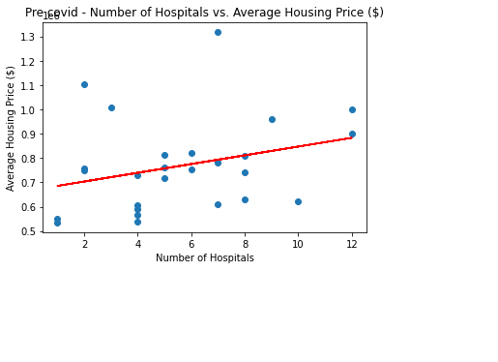
Real-Estate data before Covid
The r-squared is: 0.08410507608477118 The correlation between both factors is 0.29

Slide 7
School data

Slide 8
Hospital data

Slide 10
Data exploration & cleanup
(Jupyter Notebook)
The analysis process
(Jupyter Notebook)

Slide 11
Findings & Conclusion & Implications
Before Covid (September 2018 – January 2020)
The top 3 LGAs are: Stonnington (1), Bayside (2), Monash (3)
Hospitals: 8% of the house price can be explained by the number of hospitals
Schools: The more schools there are, the higher the total number of sales is in a Local Government area.
After Covid (February – July 2020)
Stonnington: - 23% (Most Covid-cases in April, second most in May until mid June)
Bayside: + 3.6% (Next to Stonnington, with an average number of Covid-cases)
Monash: - 9.9% (Top 5 Covid-cases in early April, top 15 Covid-cases until mid June)

